Slide 1
Image Super Resolution
Group 2
He Huang, Yixi Liang, Ruiqi Li

Slide 2
CONTENTS
Introduction
Traditional Method
CNN model
Autoencoder
GAN type model
Summary

Slide 3
Introduction
/01

Slide 4
Introduction
Image super resolution: Low-resolution -> High-resolution
Traditional Methods
Neural Networks:
- CNN
- Autoencoder
- GAN
TensorFlow Keras
Dataset: https://www.kaggle.com/datasets/quadeer15sh/image-super-resolution-from-unsplash

Slide 5
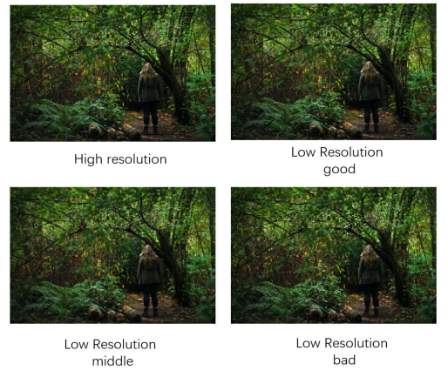
Example Image (Data)

Slide 6
Traditional Method
/02

Slide 7
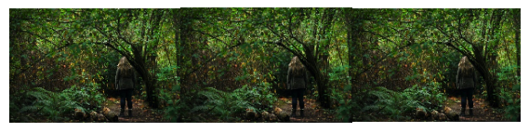
Traditional Methods
Set rules to fill up missing values of pixels
From CV2 Package
Inter Nearest: Fill up missing value with same value of its nearest pixel
Inter Linear: Uses value of ~4 pixels to fill up the missing
original inter nearest inter linear

Slide 8
CNN Model
/03

Slide 9
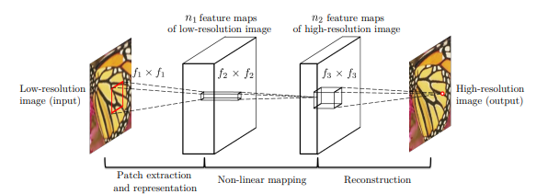
SRCNN
Dong, Chao, et al. “Image Super-Resolution Using Deep Convolutional Networks.” ArXiv.org, 31 July 2015, https://arxiv.org/abs/1501.00092.

Slide 10
1st part: Extraction Representation
n1 times of convolution operations with kernel of c*f1*f1
Y: input image
W1: filters
B1: biases
C: number of channels
*: Convolutional Operation
ReLU form output
-

Slide 11
2nd part: Non-Linear Mapping
Transforming n1-dimensional vectors to n2-dimensional vectors
n2 times of convolution operations with kernel of n1*f2*f2
W2: n2 filters of n1 * f2 * f2
B2: n2 dimensions
ReLU form output
-

Slide 12
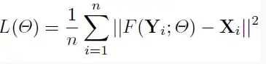
3rd part: Reconstruction
Reconstructing Image
n2 times of convolution operations with kernel of n1*f2*f2
W3: c filters of n2 * f3 * f3
B3: c dimensions
Loss function: MSE
-

Slide 13
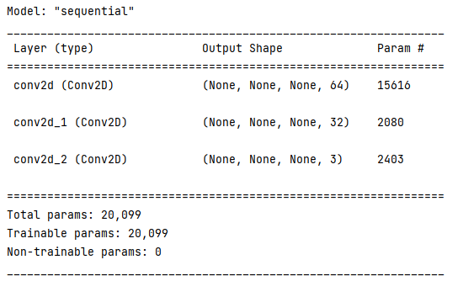
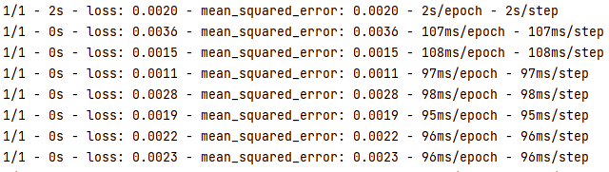
SRCNN Model Info

Slide 14
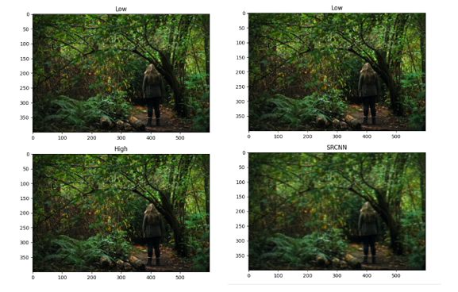
SRCNN Results
Epoch = 1

Slide 15
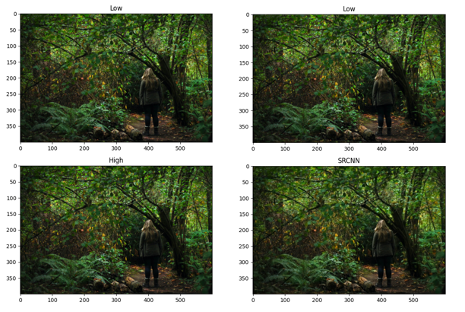
SRCNN Results
Epoch = 20

Slide 16
Autoencoder
/04

Slide 17
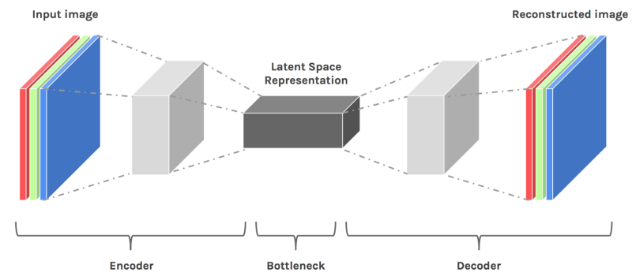
What is Autoencoder？
Autoencoder is an unsupervised artificial neural network that is trained to copy its input to output. In the case of image data, the autoencoder will first encode the image into a lower-dimensional representation, then decodes that representation back to the image. Encoder-Decoder automatically consists of the following two structures:

Slide 18
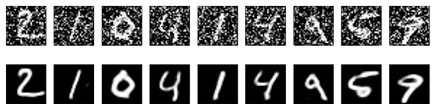
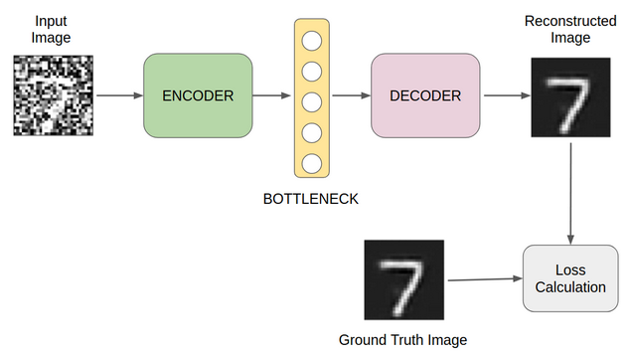
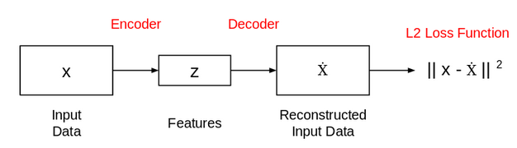
Image Denoising Autoencoder

Slide 19
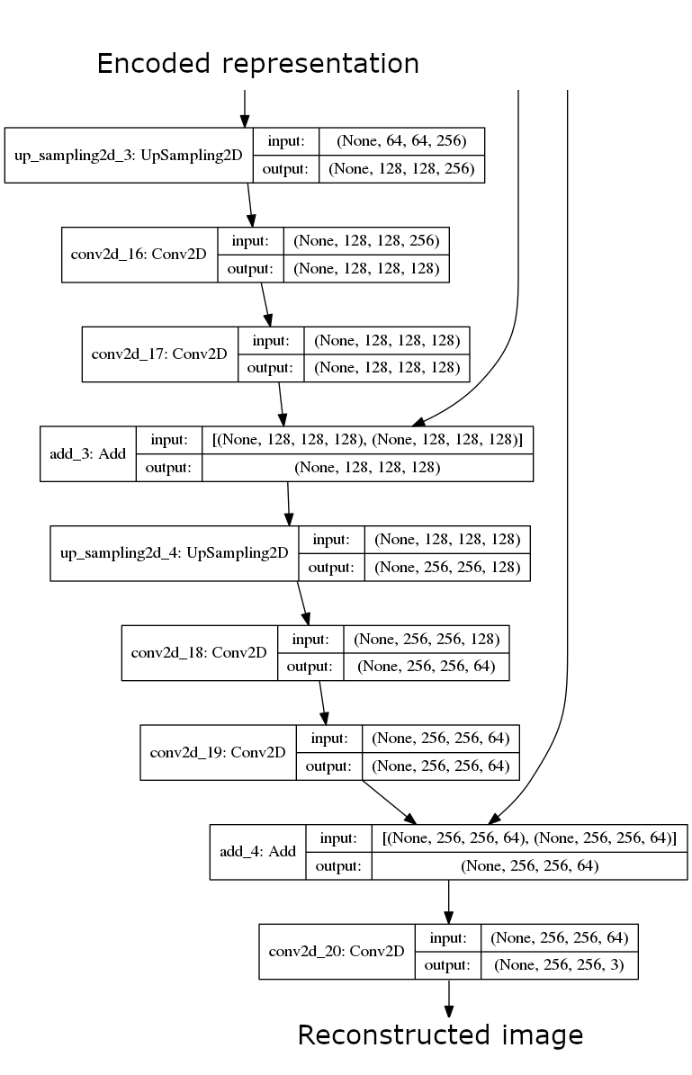
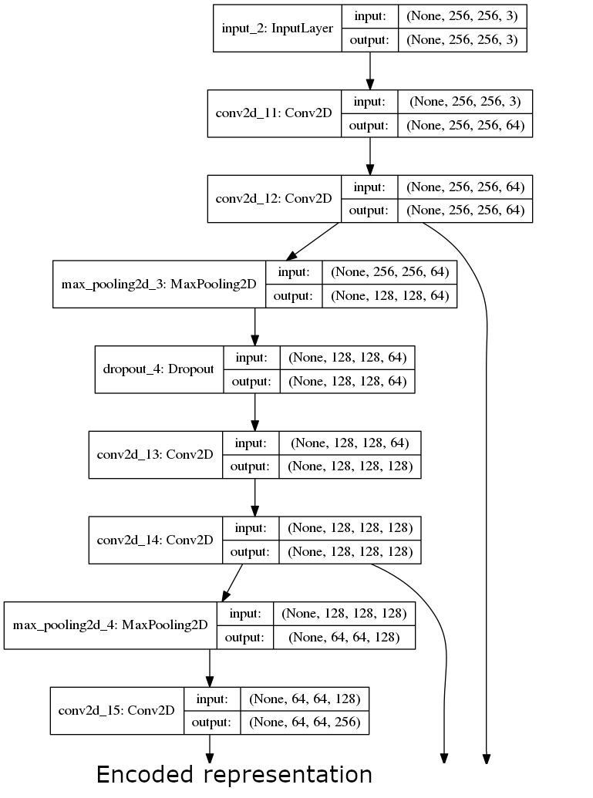
Enhance Image Resolution using Autoencoder

Slide 20
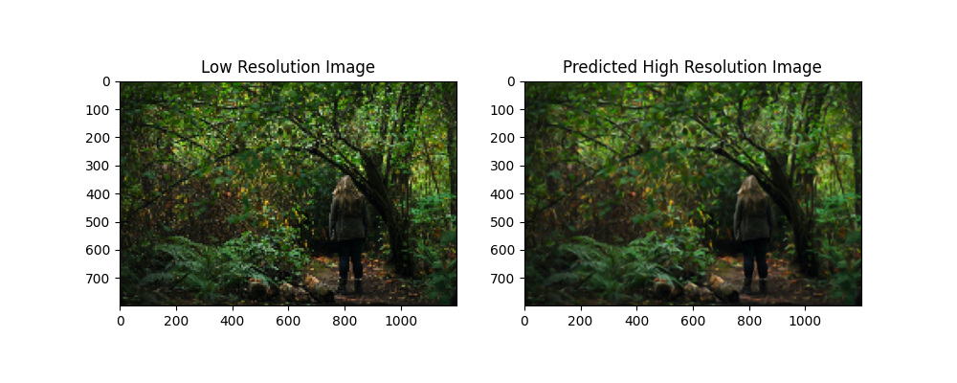
Result of autoencoder

Slide 21
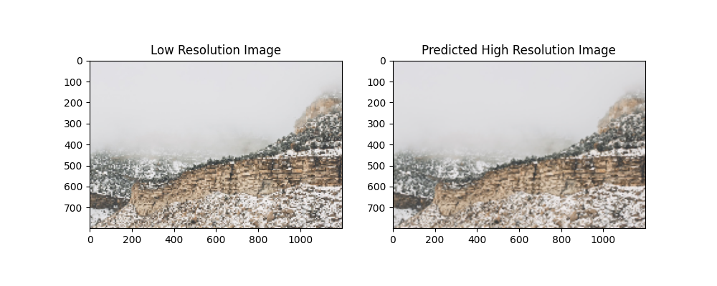
Result of autoencoder

Slide 22
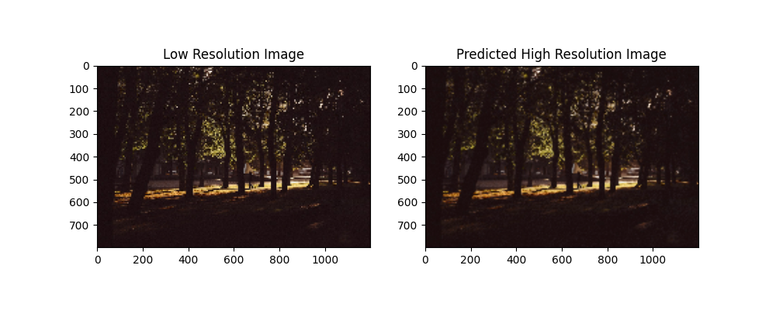
Result of autoencoder

Slide 23
GAN
/05
Generative Adversarial Network

Slide 24
How GAN works in image super resolution
High Resolution
Image
Discriminator
Low Resolution
Image
Generator
Fake
Image

Slide 25
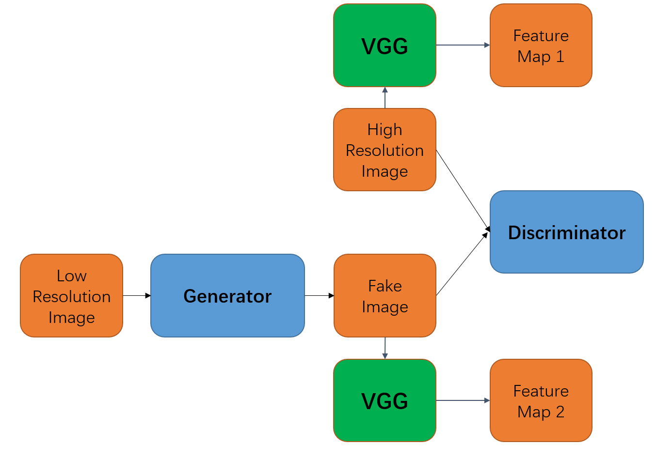
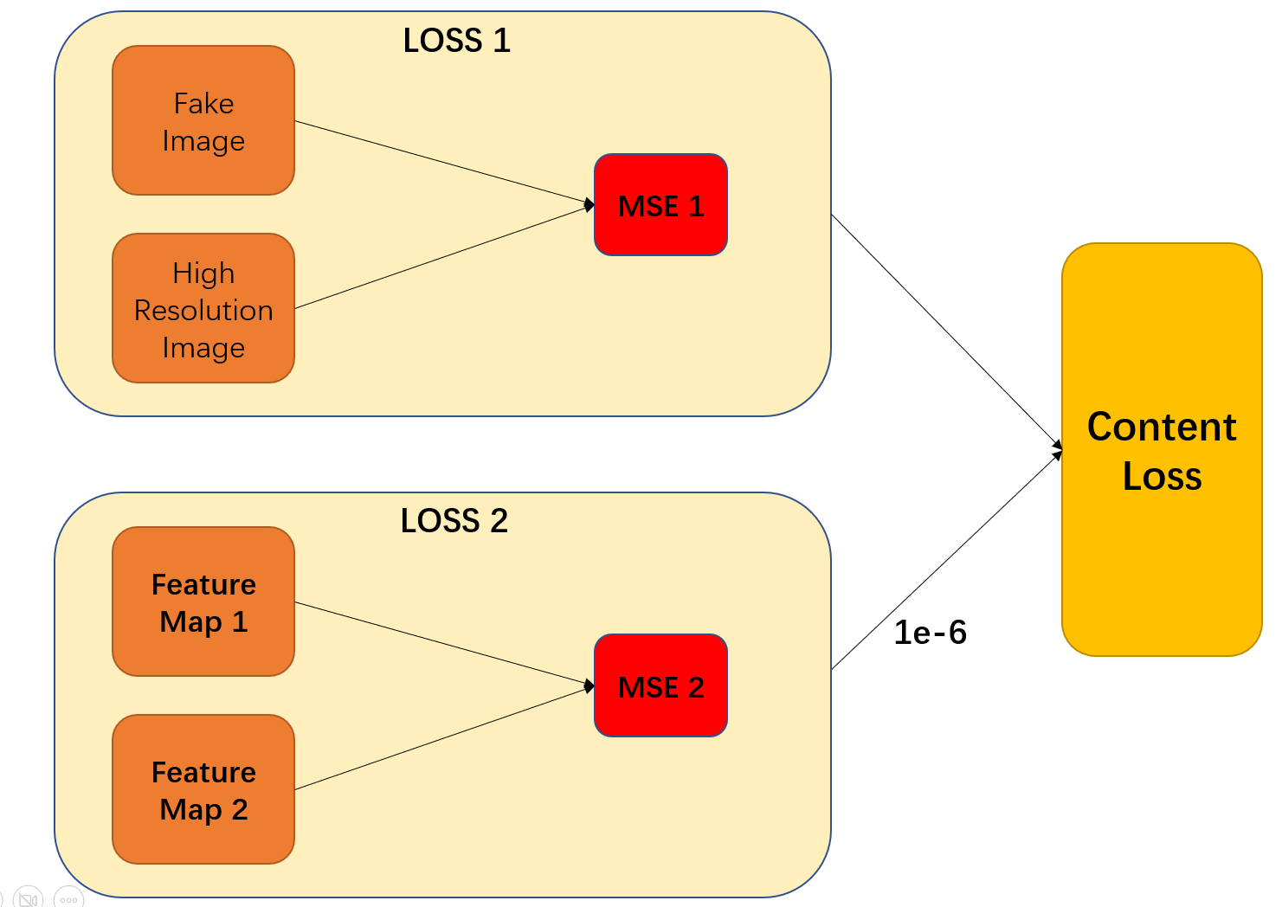
SRGAN(Super Resolution Generative Adversarial Network)
low-resolution images and high-resolution images are strictly equivalent in shape and position, and all we need to do is to add more texture on the low-resolution images
Feature map contains image texture
TOTAL LOSS = Content Loss + GAN Loss
Ledig, C., Theis, L., Huszár, F., Caballero, J., Cunningham, A., Acosta, A., ... & Shi, W. (2017). Photo-realistic single image super-resolution using a generative adversarial network. In Proceedings of the IEEE conference on computer vision and pattern recognition (pp. 4681-4690)

Slide 26
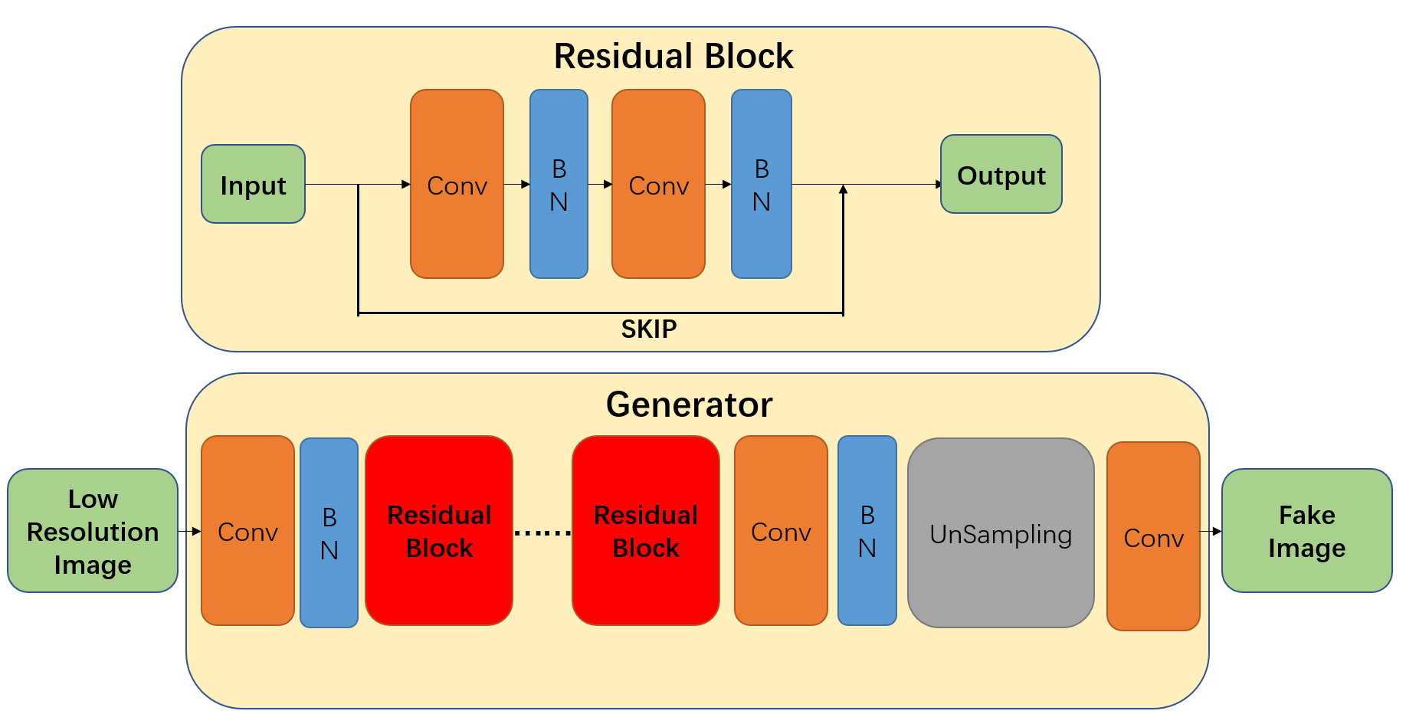
Our SRGAN
Activation function in Generator: PRelu
Discriminator is a normal CNN binary classification model
Activation function in Discriminator: LeakyRelu

Slide 27
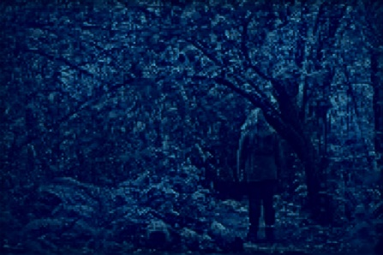
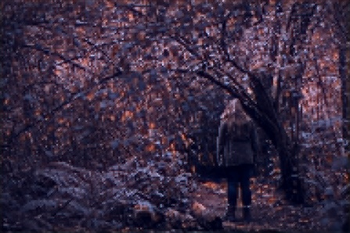
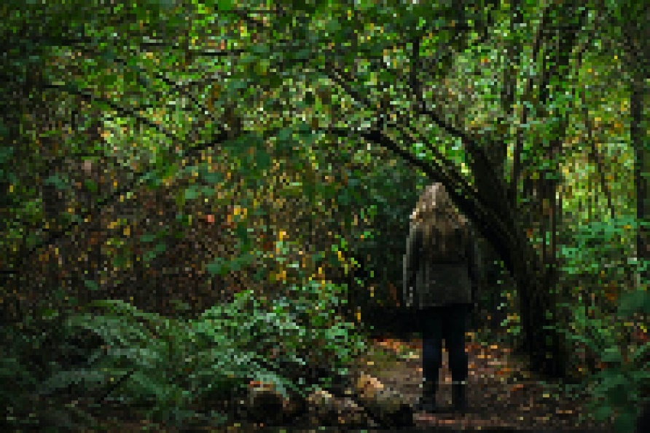
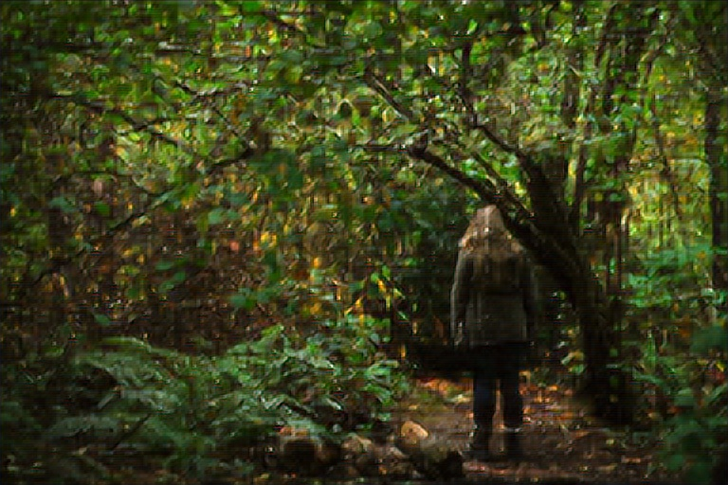
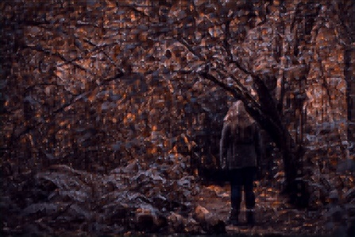
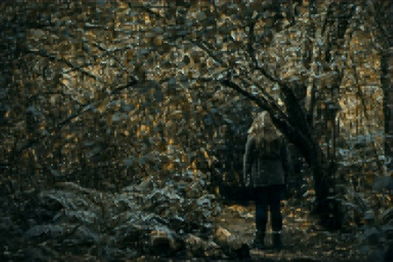
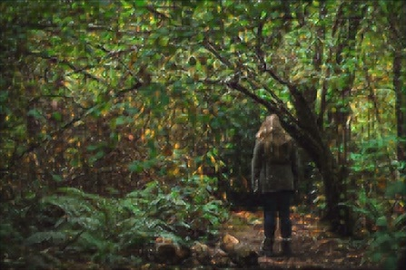
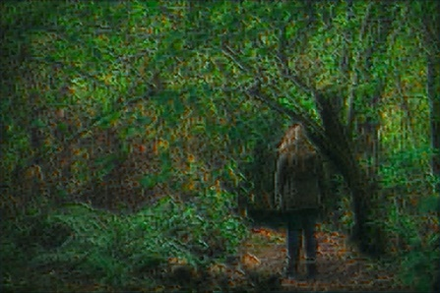
SRGAN Result
Epoch 5
Epoch 15
Epoch 25
Epoch 35
Original Low
Resolution Image
After 150 epochs
Epoch 90
Epoch 100

Slide 28
Summary
/06

Slide 29
Summary
Tradition methods in cv2 perform bad on vary low resolution image
Neural Networks’ performances are great
SRCNN
Autoencoder
SRGAN
Future
Improvement
Use more efficient structure
Use different types of image
Image augmentation

Slide 30
Thanks

